Slide 1
Supplement 246 – DICOMweb Modality Services WG27 Public Comment
November 2024

Slide 2
Work item 2023-10-C – DICOMweb Modality Services
Introduction
The DICOM Standard defines several services. Two of these are targeted towards modalities, namely the Modality Worklist service (see PS3.4, Annex K, more specifically K.6.1) and the Modality Performed Procedure Step service (see PS3.4, Annex F, more specifically F.7-F.9). Currently, these services are defined using DIMSE.
Limitations of Current Standard
Both the Modality Worklist service and the Modality Performed Procedure Step service are not yet available in DICOMweb. This limits a) the uptake of DICOMweb for modalities and b) the support of workflow services for modalities that are (intended to be) part of a web-based ecosystem.
Description of Proposal
Add the Modality Worklist and the Modality Performed Procedure Step services to DICOMweb, in principle based on the existing DICOMweb Worklist service (UPS-RS; see PS3.18, section 11). This would boil down to creating an informative annex and any normative changes needed if gaps are discovered.

Slide 3
Progress
Done since last meeting
Extensive analysis of information models of MWL/MPPS and UPS (yet unverified and unfinished)
Resulted in a few new CPs
Align MPPS Retrieve SOP Class with MPPS SOP Class
Make explicit where All [other] Attributes of … Module/Sequence can be found
Created examples of DICOMweb modality workflow communication
Agenda
Show and discuss analysis results
Show and discuss examples
Conclude on how to proceed
Discuss and conclude on what HTTP method to be used for updates

Slide 4
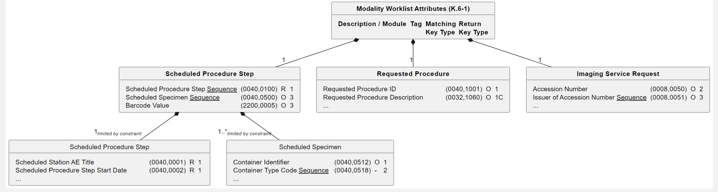
Analysis of Information Models – Introduction
Graphical representation of tables as UML class diagrams
Each table is represented by a class, having a bold name, showing the (relevant) columns
Each sub-table (identified by a bold heading in the table) is represented by a class having a bold name which is contained in the table class (1:1)
Sequences are underlined, to signify the fact that elements of each sequence are represented by a class, contained in the class using the sequence (0:n when unconstrained)
Diagrams contain only explicitly mentioned sequences, not those in All [other] Attributes …
Each inclusion is represented by a class, contained in the including class, that shows the include italic
Implicit attributes (included by All [other] Attributes …) are given starting with a dash
Description / Module | Tag | Matching Key Type | Return Key Type
Scheduled Procedure Step
Scheduled Procedure Step Sequence | (0040,0100) | R | 1
>Scheduled Station AE Title | (0040,0001) | R | 1
>Scheduled Procedure Step Date | (0040,0002) | R | 1
>…
Scheduled Specimen Sequence | (0040,0500) | O | 3
>Container Identifier | (0040,0512) | O | 1
>Container Type Code Sequence | (0040,0518) | - | 2
>…
Barcode Value | (2200,0005) | O | 3
Requested Procedure
Requested Procedure ID | (0040,1001) | O | 1
Requested Procedure Description | (0032,1060) | O | 1C
…
Imaging Service Request
Accession Number | (0008,0050) | O | 2
Issuer of Accession Number Sequence | (0008,0051) | O | 3
…

Slide 5
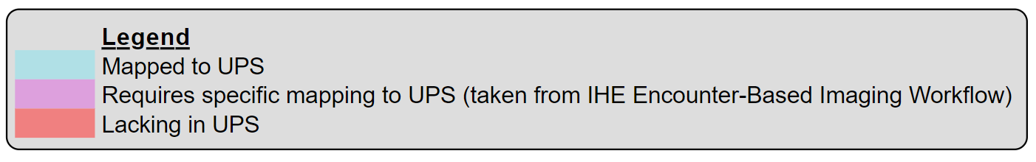
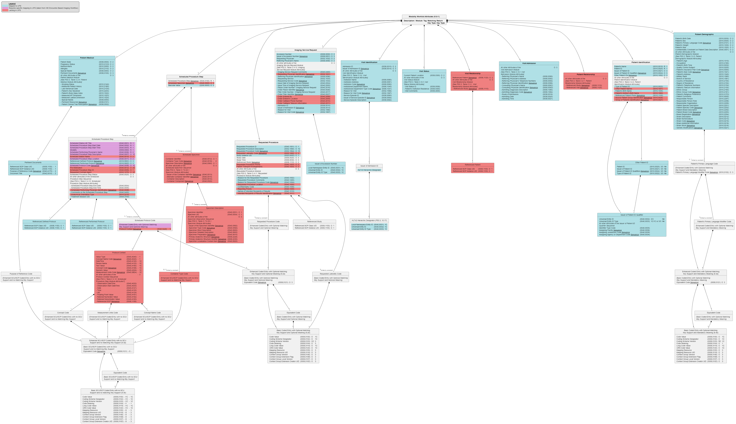
Analysis of Information Models – MWL
Lacking in UPS
Modules/Sequences
Visit Relationship
Patient Relationship
Specimen
…
Attributes
Scheduled Procedure Step ID
Requested Contrast Agent
Other Patient Names
…
Incompatibility
MWL’s Scheduled Protocol Code Sequence has two parts, of which the Protocol Context Sequence is not part of the UPS’s Scheduled Workitem Code Sequence to which EBIW maps it.
Furthermore, there’s no distinction between ‘primary’ and equivalent codes in UPS.

Slide 6
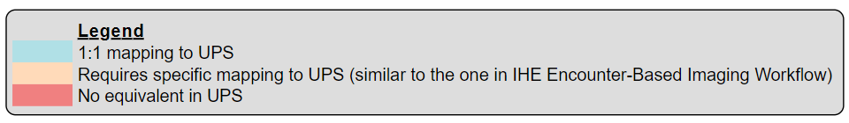
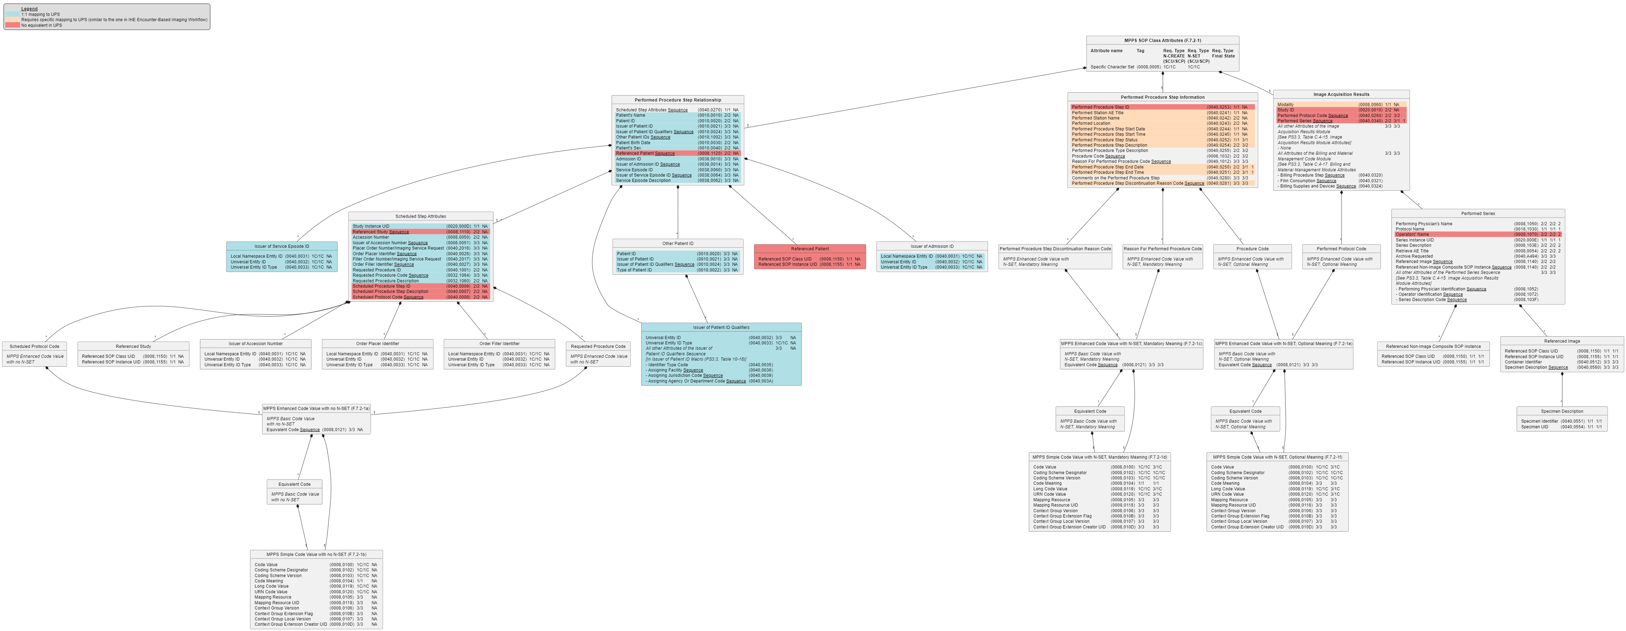
Analysis of Information Models – MPPS
Incompatibility
Is mapping from MPPS’ Performed Procedure Step Status DISCONTINUED to / from UPS’ Procedure Step State CANCELLED semantically correct? And what about the SCHEDULED value?
Lacking in UPS
Modules/Sequences
Referenced Patient
Referenced Study
…
Attributes
Scheduled Procedure Step ID
Scheduled Procedure Step Description
…
Incompatibility Mapping from MPPS’ Performed Procedure Step Discontinuation Reason Code Sequence to / from UPS’ Procedure Step Discontinuation Reason Code Sequence is possible, as both allow for multiple codes, but in MPPS there is one ‘primary’ code with possible equivalents, while UPS does not state how the codes are related.

Slide 7
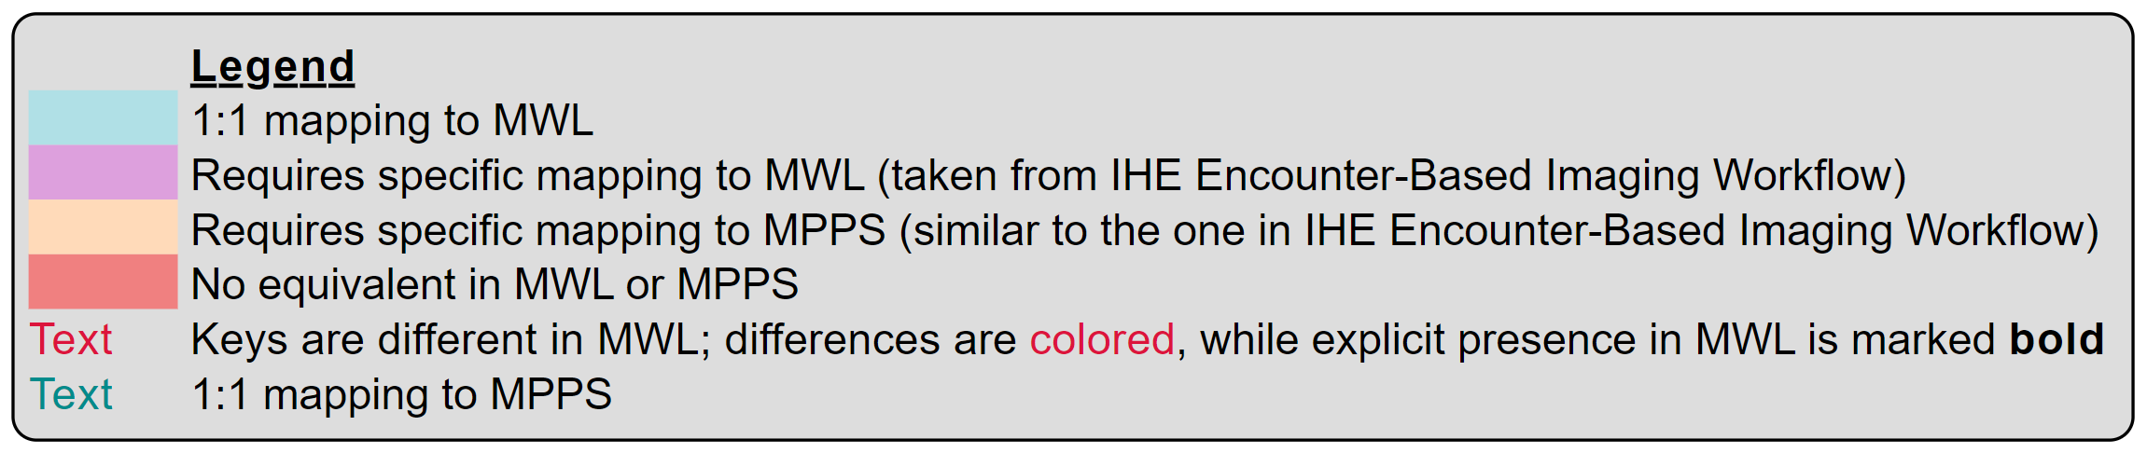
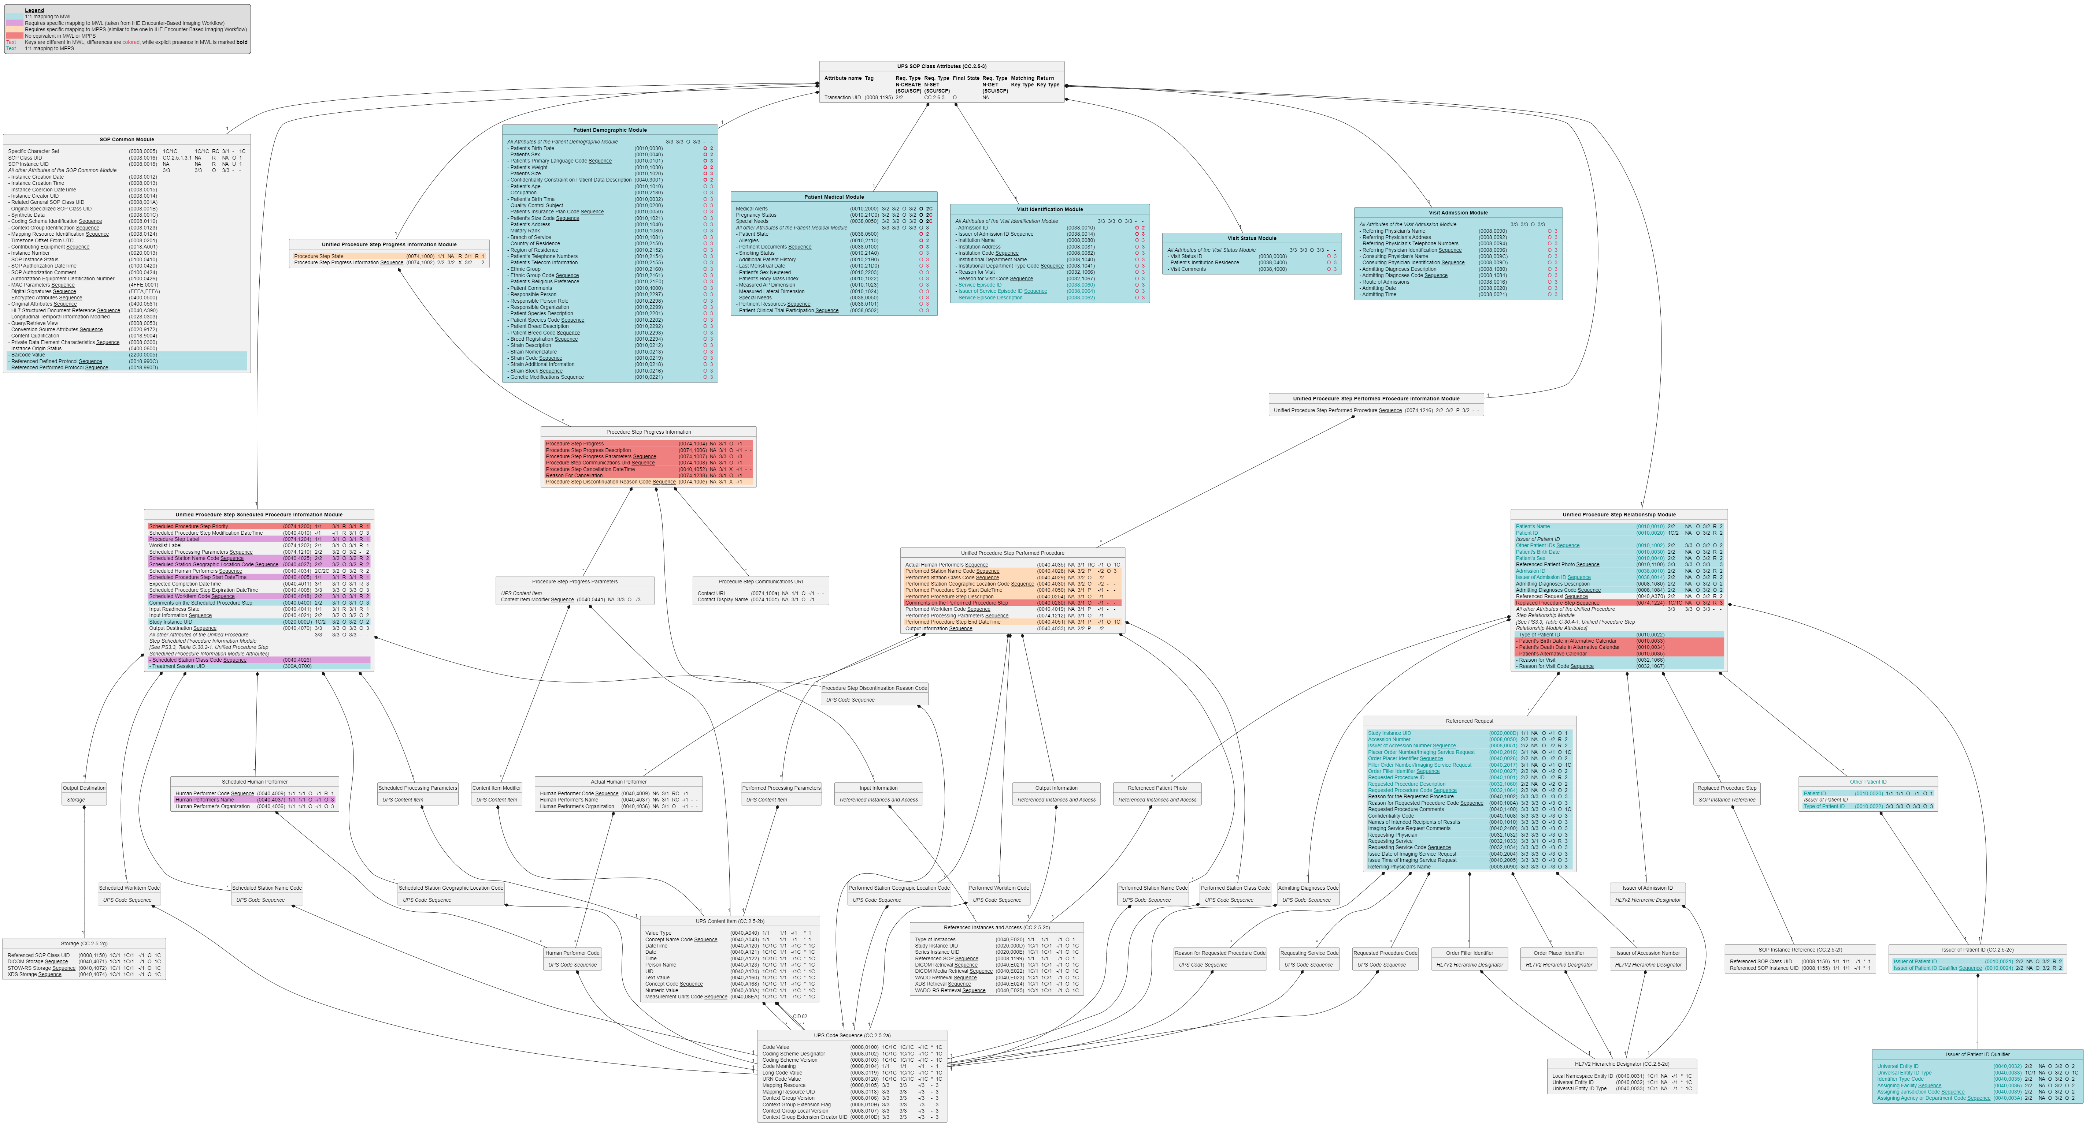
Analysis of Information Models – UPS
Lacking in MWL/MPPS
Modules/Sequences
…
Attributes
* Alternative Calendar *
* Progress *
* Cancellation *
Scheduled Procedure Step Priority
…
Incompatibilities
Cardinality
In MWL Imaging Service Request has a 1:1 relationship, while in UPS
Referenced Request has a 1:n
Relationship.
In MWL the Performed Procedure
Step has a 1:1 relationship, while in
UPS the Performed Procedure Step
has a 1:n relationship.
Attribute Keys
For many attributes in ‘shared’
modules, keys have been defined
differently (MWL: O and 2 or 3 and UPS - and -.

Slide 8
Breaking Changes for Mapping MWL/MPPS to UPS (1)
The meaning of - for Matching and Return Key Type seems undefined. It is assumed that it means that the SCP’s support of the Attribute is Undefined, as is for the N-CREATE, N-SET, and N-ACTION (see PS3.4, Section 5.4.2.1)
Matching Key Type and Return Key Type for many attributes are then defined as being Undefined in UPS while these are defined as O and 2 (or 3) in MWL.
Although it is not defined what Undefined means, it may mean that when an MWL SCU queries a UPS SCP using one of these keys, one UPS SCP does filter on it, and another one will not, even when having the same Scheduled Procedure Steps.
The above is not interoperable and does require a change when mapping between MWL and UPS, but that would break the current definition.
What if the - for Matching and Return Key Types means that it is not allowed?
That would lead to an even a stronger case for a breaking change.

Slide 9
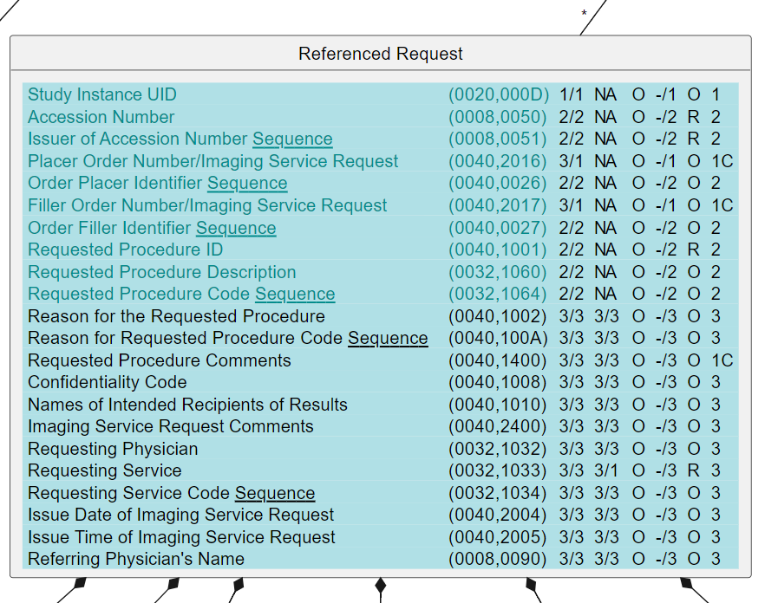
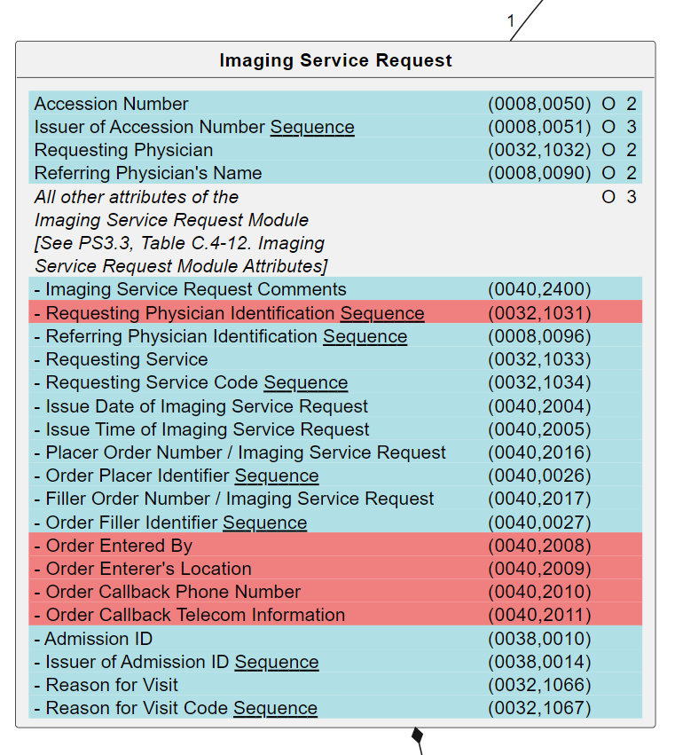
Breaking Changes for Mapping MWL/MPPS to UPS (2)
UPS’ Referenced Request (RR) and MWL’s Imaging Service Request (ISR) serve a similar goal, recording what has been requested:
However, UPS has a 0:n relationship with RR, while MPPS has a 1:1 relationship with ISR
Consequence is that when retrieving a referenced request in UPS, it may not be mappable to one imaging service request. Therefore, a change would be needed, but that would break the current definition.
page 397
page 244

Slide 10
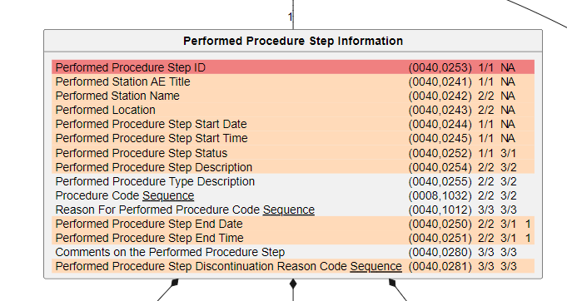
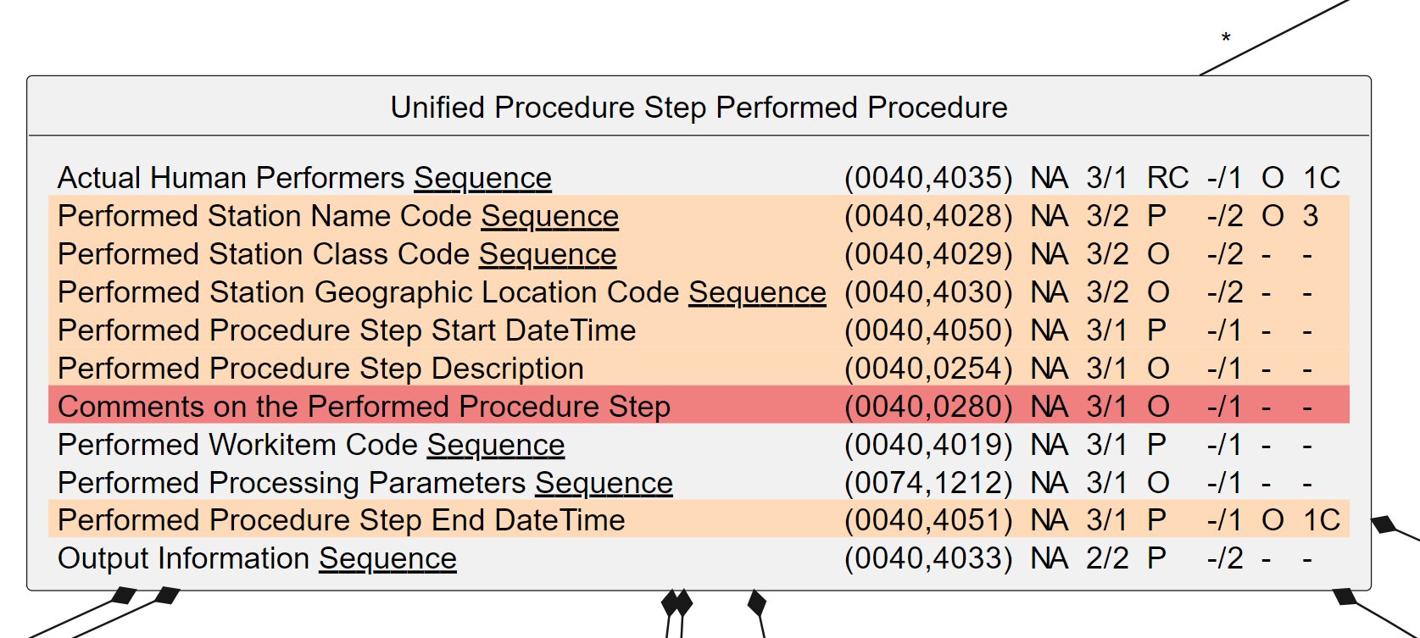
Breaking Changes for Mapping MWL/MPPS to UPS (3)
UPS’ Unified Procedure Step Performed Procedure (UPSPP) and MPPS’ Performed Procedure Step Information (PPSI) serve a similar goal, recording what has been performed:
However, UPS has a 0:n relationship with UPSPP, while MPPS has a 1:1 relationship with PPSI
Consequence is that when retrieving a PPS in UPS, it may not be mappable to one PPSI. Therefore, a change would be needed, but that would break the current definition.
page 400
page 166

Slide 11
Breaking Changes for Mapping MWL/MPPS to UPS (4)
Mapping of items that have semantic differences is not possible unless one of the definitions changes, but that would lead to a breaking change.
MWL and MPPS have several structures that identify several equivalent codes next to a ‘primary’ code. Similar structures in UPS just define a bunch of codes without any relations. This is unmappable without consequences.
Examples include the (Performed) Procedure Step Discontinuation Reason Code Sequences and the Scheduled Workitem Code Sequence (UPS) vs. the Schedule Protocol Code Sequence (MWL).
The states of a UPS are {SCHEDULED, IN PROGRESS, COMPLETED, CANCELED}, while the states of MPPS are {IN PROGRESS, COMPLETED, DISCONTINUED}. How are these to be mapped without unwanted consequences?
Notifications in UPS can contain quite some details (see PS3.4, Table CC.2.4-1. Report a Change in UPS Status - Event Report Information) while notifications in MPPS do not have details (Table F.9.2-1. Performed Procedure Step Notification Event Information). This is unmappable without consequences. And we’re even not looking at the Event Type differences here…

Slide 12
DICOMweb MWL/MPPS Examples

Slide 13
Conclusion
Mapping DIMSE MWL/MPPS to UPS(-RS) and vice versa has insurmountable problems, related to
Compatibility – taking away incompatibilities would require a) breaking changes and b) a tremendous amount of work (which would be beyond the scope of this supplement)
Efficiency – mapping all attributes in both directions would require a large amount of effort (even after having made the information models compatible)
Sticking the head in the sand by ignoring the inherent complexities and ‘just’ looking at some straightforward use cases will give the wrong impression (and will lead to backtracking, and not just one time)
Usability – it would result in a specification that is very complex to use, aiming for low adoption to begin with
Implementing proxies (for hybrid settings with DIMSE and DICOMweb systems) would be very cumbersome and error-prone due to the huge amount of details
It is, however, relatively straightforward to map DIMSE MWL/MPPS to new DICOMweb services and resources, e.g.
C-FIND_{MWL} GET SP /modality-worklist?{&match*}{&includefield}{&fuzzymatching}{&offset}{&limit} SP version CRLF
N-CREATE_{MPPS} PUT SP /modality-performed-procedure-steps/{mppsUID} SP version CRLF CRLF payload
N-SET_{MPPS} PATCH SP /modality-performed-procedure-steps/{mppsUID} SP version CRLF CRLF payload
N-GET_{MPPS} GET SP /modality-performed-procedure-steps/{mppsUID} SP version CRLF
N-EVENT-REPORT_{MPPS} POST SP /modality-performed-procedure-steps/{mppsUID}/subscribe/{aetitle} SP version CRLF DELETE SP /modality-performed-procedure-steps/{mppsUID}/subscribe/{aetitle} SP version CRLF
The above would be complete by definition, covering all possible use cases and all inherent complexity
MPPS Notifications are an intrinsic exception, as there is an issue with the Standard not having specified how SCPs know what SCUs to notify
Therefore, create new Modality Services resources instead of basing ‘MWL-RS’ / ‘MPPS-RS’ on UPS-RS (the DICOMweb Worklist service)

Slide 14
What HTTP Method is to be Used for Updates etc?
PATCH versus PUT and POST
The PUT method provides a replacement of the entire resource (and thus requires bandwidth).
The POST method doesn’t have any generic semantics.
“Server and client-side developers must write application-specific code to support it, then do QA on it, debug the corner cases, and eventually rewrite the API to fix the problems they inevitably find (partial updates can get subtle). Once you get a lot of these hanging around, it’s a pain.”
The PATCH method is a request method for making partial changes to an existing resource.
It is atomic, so either all or no changes
The current PUT for the Change Workitem State Transaction in UPS-RS is weird
Requires a separate resource for changing a state, not the intent of HTTP

Slide 15
References
This presentation, the examples and the analysis images (and much more) can be found at
https://github.com/krotz-dieter/dicomweb-dmwl-mpps

Slide 16
Difference 1 – Undefined Keys
The UPS SOP Class defines many attributes as ‘undefined’ (“-”) for Matching Key and Return Key; this is done by referring to All [other] Attributes of the […] Module.
This is for instance the case for the attributes of most of the Modules that are shared with MWL: Patient Demographic, Visit Identification, Visit Status and Visit Admission.
Note that the Patient Medical Module is an exception; this sets the Matching Key and Return Key for All other Attributes … to O and 3 respectively. Here, however, some of the attributes – e.g. Medical Alerts – are 2C in UPS while being 2 in MWL
MWL has the attributes of these Modules defined – most of them also implicitly – as O and 2 or 3 for Matching Key and Return Key respectively.
As in UPS the SCP support of these attributes is undefined (which is practice means: not supported at all) and MWL does allow their use, a proper (at least: workable) mapping is impossible, and changing this would require a breaking change.

Slide 17
Difference 2 – Structure of Information Models
Major differences
MWL has a 1:1 relation with Imaging Service Request, while UPS has a 1:n relation with Referenced Request
UPS has a 1:n relation with Performed Procedure (Step), while MPPS has a 1:1 relation with it
MWL has a 1:1 relation to both Visit Relationship and Patient Relationship, while these are absent in UPS
…
Only some minor differences (as there are many)
UPS cannot handle specimen
There is no notion of alternative calendar in MWL, while there is in UPS
There are no notions of other patient names or mother’s birth name in UPS, while there are in MWL
…
Might be solvable, but would require a lot of work, aligning the respective definitions without exceptions

Slide 18
Difference 3 and 4 – Process Models
MPPS cannot make explicit that a Performed Procedure Step has been cancelled, while this is possible in UPS
The granularity of notifications in MPPS is on state only, while UPS supports notifications on any changes

Slide 19
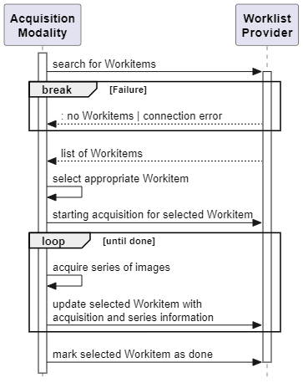
Examples of Workflow Communication
Scheduled Workflow
Search for workitems search
Start acquisition for workitem create
Update workitem update
Mark workitem as done update

Slide 20
Proposed Approach
Add the DIMSE Modality Worklist and the Modality Performed Procedure Step services to DICOMweb as a new service.

